Slide 1
Building .NET Applications Across Clouds with .NET Aspire
Norm Johanson
Principal Engineer at AWS
@socketnorm (X / Twitter)
Scott Hunter
VP at Microsoft
@coolcsh (X / Twitter)

Slide 2
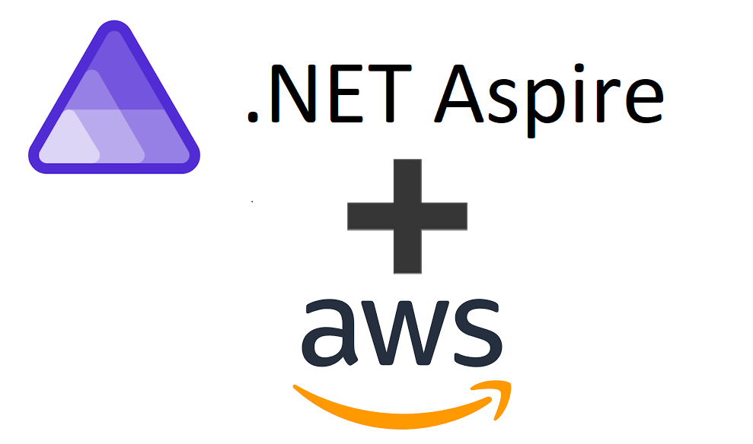
What is AWS support for Aspire?
Focusing on the dev inner loop
Provisioning AWS Application Resources
Integrated into the Aspire AppHost startup
NuGet Package Aspire.Hosting.AWS
Resources are provisioned with AWS CloudFormation

Slide 3
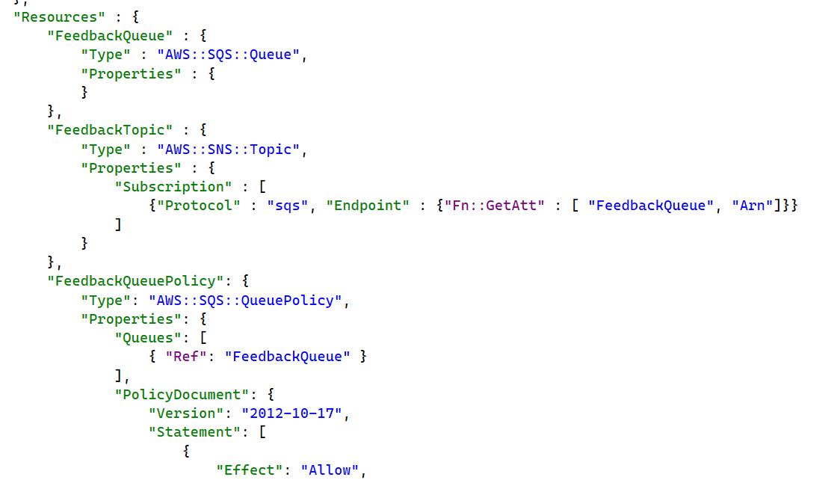
What is AWS CloudFormation?
AWS's Aspire support uses AWS CloudFormation for provisioning
A CloudFormation Stack is the container for provisioned resources
Resources are create, updated and deleted as a single unit.
Resources are defined in a JSON/YAML template

Slide 4
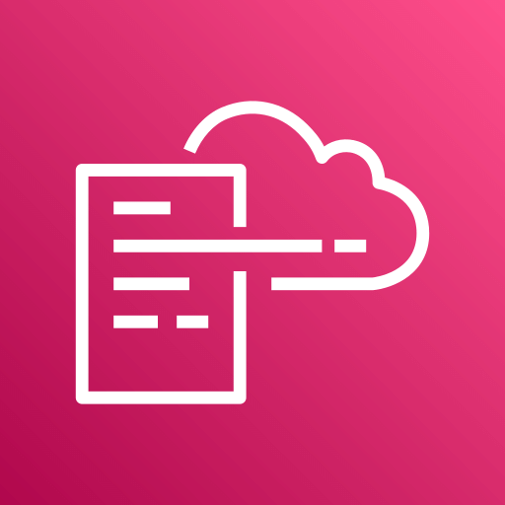
Demo: CloudFormation

Slide 5
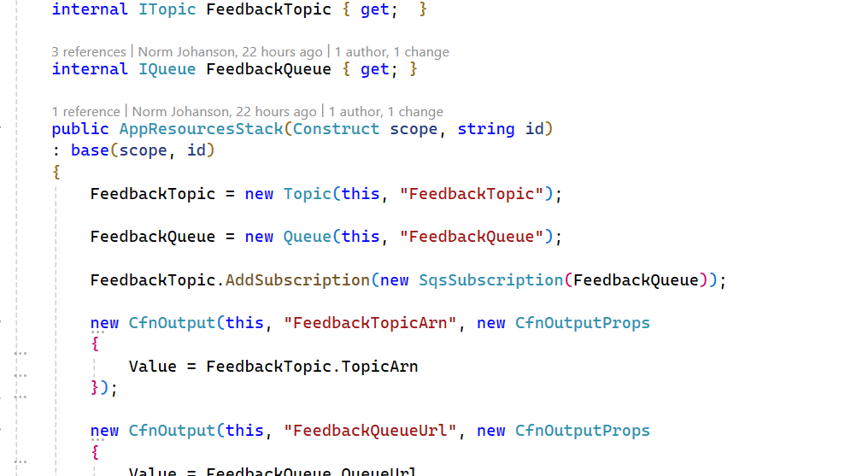
What is AWS Cloud Development Kit (CDK)?
Programmatic abstraction on top of CloudFormation’s declarative provisioning
Define your resources in code
Code generates a CloudFormation template
Resources are provisioned using CloudFormation
CDK’s Node.js dependency
Requires Node.js to be installed
Node.js usage is transparent to Aspire users

Slide 6
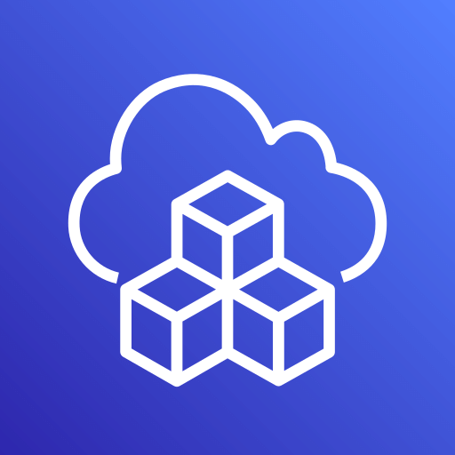
Demo: CDK

Slide 7
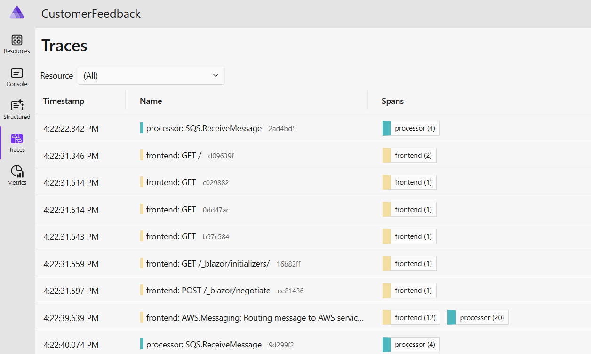
OpenTelemetry and .NET Aspire
OpenTelemetry lets you see what your application is doing under the covers.
Aspire Dashboard shows Traces and Metrics
Instrument AWS SDK with OpenTelemetry.Instrumentation.AWS NuGet package
See what AWS calls your application is making.

Slide 8
Wrap up
Aspire.Hosting.AWS NuGet package GA
Applications resource can be provisioning either declarative of programmatic using AWS CloudFormation
Love to hear feedback: https://github.com/aws/integrations-on-dotnet-aspire-for-aws
Add AWS OpenTelemetry support using the OpenTelemetry.Instrumentation.AWS package
Thank you to the .NET Team for their partnership

Slide 9
Thank You

